Slide 1
pdas ca2 assignment public transport DATA ANALYSIS
JAYDEN YAP JEAN HNG P2112790 DAAA 1B 04
Notes:
Good morning Ms Tan, here’s my analysis on the HDB Datasets

Slide 2
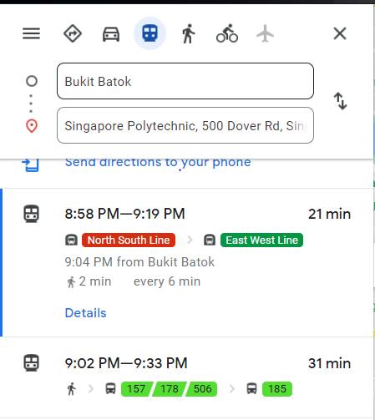

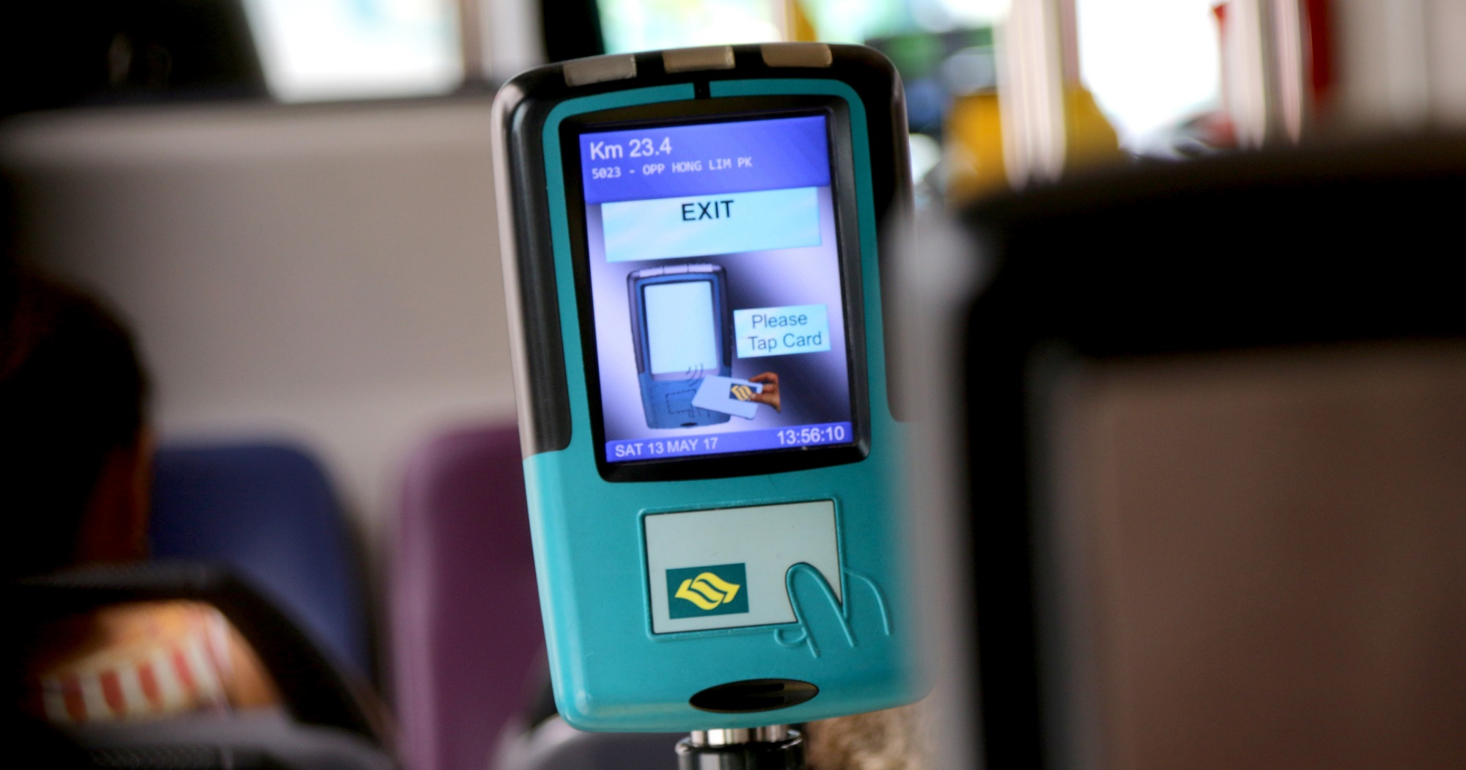
Public transport is hard
Notes:
Good morning Ms Tan, here’s my analysis on the HDB Datasets

Slide 3

If we make the wrong decision…
Notes:
Good morning Ms Tan, here’s my analysis on the HDB Datasets

Slide 4


Distance-based fares introduced in 2010
Introduced to Singapore in 2010, Distance-Based fares charges based on the total distance travelled in one journey, regardless of the mode of transport used and omitting boarding charges for every trip.
To encourage flexibility in commuting patterns, a single journey allows for up to 5 transfers, so long as the transfers are made within a timeframe stipulated under DBF guidelines.
Implemented to allow for more ‘fair’ charges for commuters
Notes:
Good morning Ms Tan, here’s my analysis on the HDB Datasets

Slide 5
Let’s investigate!
Notes:
Good morning Ms Tan, here’s my analysis on the HDB Datasets

Slide 6
objectives
1. Compare our current-day Distance Based Fares (2020) against Non-Distance Based Fares (2009), to see how the fare structure affected Singaporeans’ total spendings on the daily commute
2. Investigate the different fare options available to SP Students, to see which is the most worthwhile, depending on how one travels
Notes:
My objectives for this analysis were very specific. First, analyse households by Flat Type. Secondly, analyse by ethnic group to see how cultural differences affect living. Thirdly, analyse family nucleus types. Fourthly, analyse resale prices to find out about affordability. Fifth, find relationship between size and price of flats. And lastly, analyse age to find out about Aging Population.

Slide 7
DATASET LINKS
Monthly Concession Pass Prices (2020) and (2009)
Fares for Feeder Bus Services (2020) and (2009)
Fares for MRT (2020) and (2009)
Public Transport Utilisation - Average Daily Public Transport Ridership
Notes:
Heres the datasets I used

Slide 8
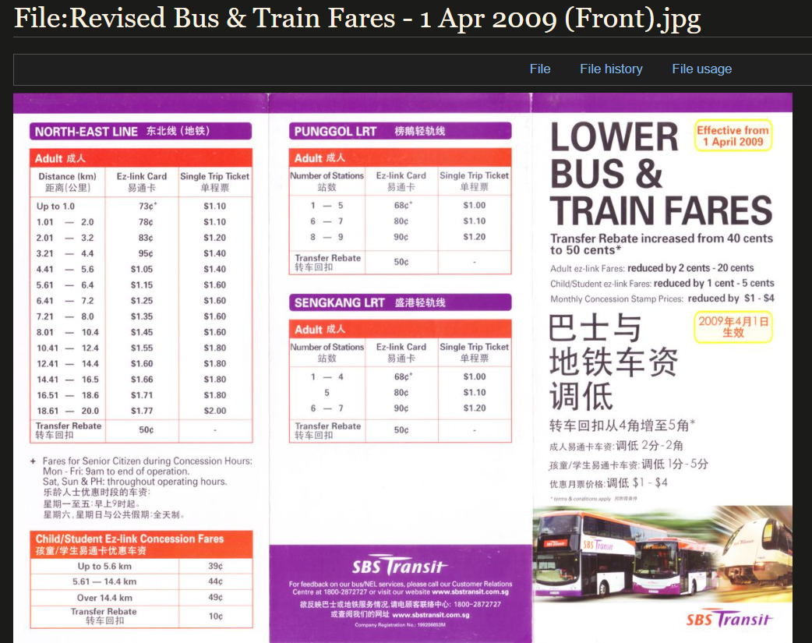
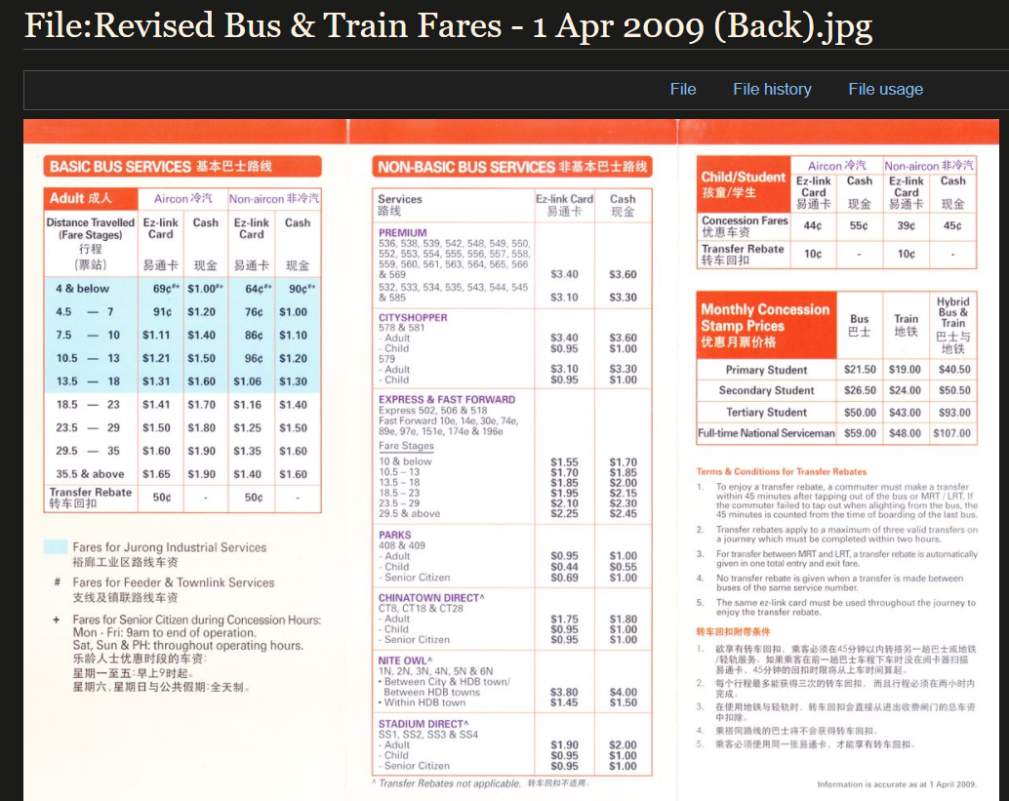
2009 data from sg wiki
Notes:
Heres the datasets I used

Slide 9
Dataset 1: monthly concession pass prices (2009 & 2020)
Notes:
Starting with 1st dataset on flat types

Slide 10
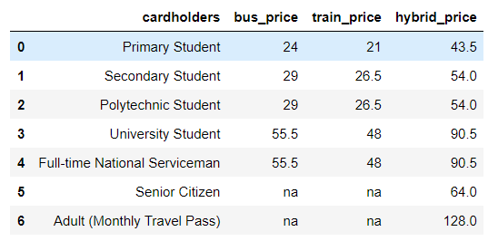
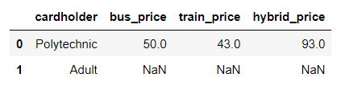
DATASET 1
2020
Shows prices of concession passes ($): monthly passes which can be purchased for unlimited travel
2020 data Includes many different rows for different cardholders
Peculiarities: Senior citizen and adults have no option to get bus or train passes, only a bus AND train pass is available to them.
2009 data only includes Polytechnic students and Adults data
2009
Notes:
Heres the numpy summary. I decided to use a histogram to analyse the shape of distribution of my data

Slide 11
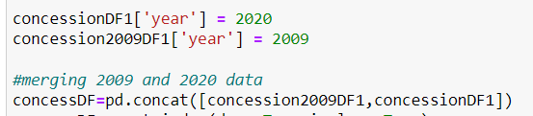
DATASET 1 cleaning
Df.rename() to rename columns, and dropping ‘cardholder’ column after melting, so that the ‘terms’ in the 2 datasets match each other
Use of pd.melt to melt the dataset such that the columns for bus train and hybrid prices would turn into a single column called ‘type’
Created a ‘year’ column in both 2009 and 2020 datasets then merged them into one dataframe
Notes:
Heres the numpy summary. I decided to use a histogram to analyse the shape of distribution of my data

Slide 12
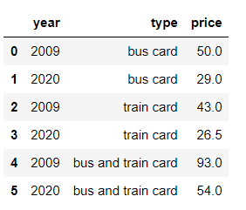
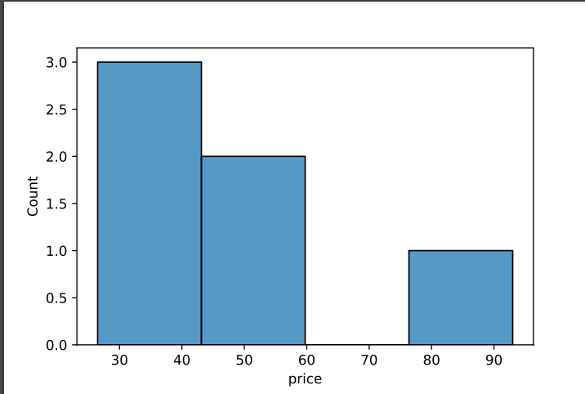
DATASET 1 insights
Final Dataframe:
1. More compact than before
2. Much easier to read to see the differences in price between each year
3. ‘Type’ column will be great for use in graphs as a categorical variable
4. Histogram has little data points to work with, can’t make out a distribution shape
Notes:
Heres the numpy summary. I decided to use a histogram to analyse the shape of distribution of my data

Slide 13
Dataset 2: feeder bus fares (2009 & 2020)
Notes:
Lets move on to 2nd dataset about family nucleus types

Slide 14
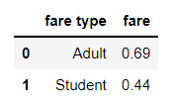
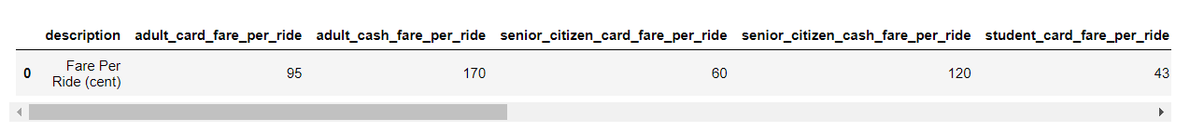
DATASET 2
2009
2020
Feeder bus Fares
(Feeder bus services are designed to pick up passengers in a certain locality and take them to a transfer point where they make an onward journey on a trunk service)
Will be used to calculate monthly travel costs. We assume One Feeder Bus ride + One MRT ride per trip
Peculiarities: 2020 data is in a strange format where there is only 1 row but many columns.
2009 data only includes Adult and Student data
2009 fare prices are in dollars and not cents
Notes:
Heres the numpy summary. I decided to use a histogram to analyse the shape of distribution of my data

Slide 15
DATASET 2 cleaning
Use of df.transpose() for 2020 dataset to standardize the shape for both 2009 and 2020 data
Applied lambda function with df.apply() to convert dollars into cents for 2009 data
Split 1 column (‘fare_type’) into 2 columns (‘Type’ and ‘Year’)
Notes:
Heres the numpy summary. I decided to use a histogram to analyse the shape of distribution of my data

Slide 16
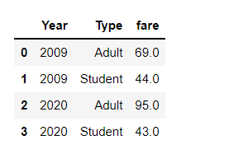
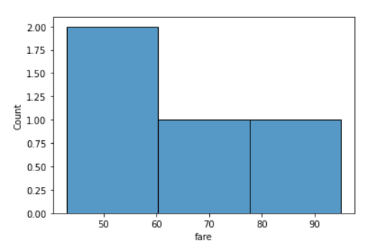
DATASET 2 insights
Final Dataframe:
1. More compact than before
2. Much easier to read to see the differences in price between each year
3. We can tell that Student fares have not changed much between 2009 and 2020 (44 to 43 cents)
4. Too little datapoints to work with for Histogram

Slide 17
Dataset 3: mrt fare prices (2009 & 2020)

Slide 18
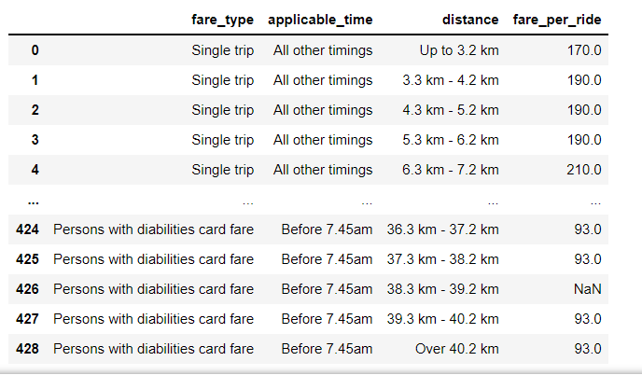
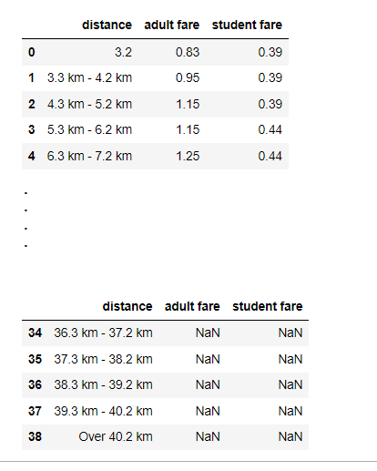

DATASET 3
2020
Shows prices of MRT fares by distance travelled ,card type and time of day. Before 7.45am, commuters are given discounts (pre-peak hour)
Peculiarities: Distance column has data formatted as ‘x’km-’y’km, and is hence treated as strings.
2009 Data does not have a column for applicable_time. This is because the pre-peak hour discount was not implemented until 2017
2009

Slide 19
DATASET 3
2009 Data has many null values for distances more than 20km. This is likely due to the MRT lines being much shorter in the past, so they did not have to accommodate for prices at that distance.
> We will keep these null values, but when we draw our comparisons in graphs, we only compare for the first 20km.
>More practical because it is very rare that one commutes more than this distance
>The distance between SP and Changi Airport is only 30km!
2009
Notes:
Heres the numpy summary. I decided to use a histogram to analyse the shape of distribution of my data

Slide 20

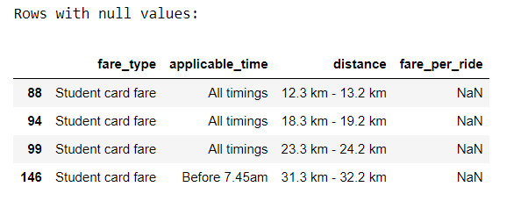
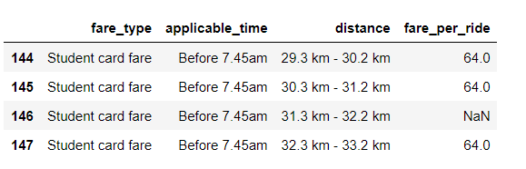
DATASET 3 cleaning (null values)
4 rows with null values (fares)
Notice that in the rows surrounding the row with null value, the fares are all the same
Hence, I use df.fillna with method of forward fill to fill these null values
After checking the website for fares, this is correct

Slide 21
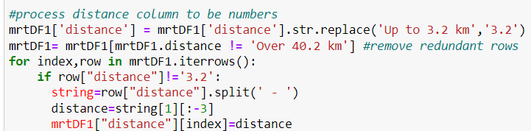
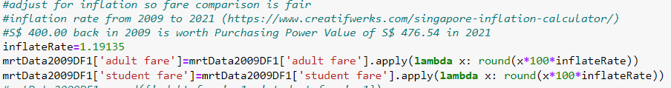
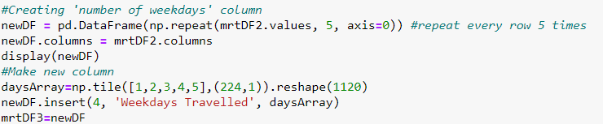
DATASET 3 cleaning
Use of for loop and df.iterrows() to format the ‘distance’ column into float values instead of strings
Used df.apply with lambda functions to adjust the 2009 prices for inflation (from 2009 to 2020)
Created a new column ‘Weekdays Travelled’ ranging from 1 to 5 for each row, this is to aid in estimating travel costs

Slide 22
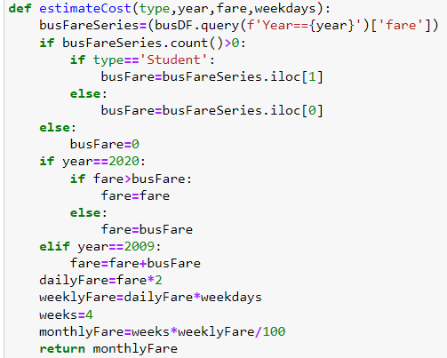
DATASET 3 cleaning
Created ‘year’ columns for datasets so they could be merged easily
Then, merge with pd.concat()
Created a function for estimating the monthly cost of travel for an average student or working adult, depending on:
Card type (Adult/Student)
Year (2009/2020)
If 2009: Bus fare is added to total fare (not distance-based fares like 2020)
If 2020: As long as MRT fare was higher than Bus fare, then no additional charges
Fare (Numerical based on distance travelled)
Weekdays travelled in a week (1-5)
Loop through dataframe and pass values into function

Slide 23
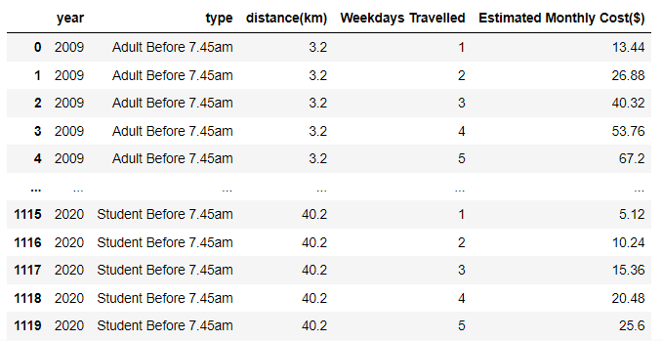
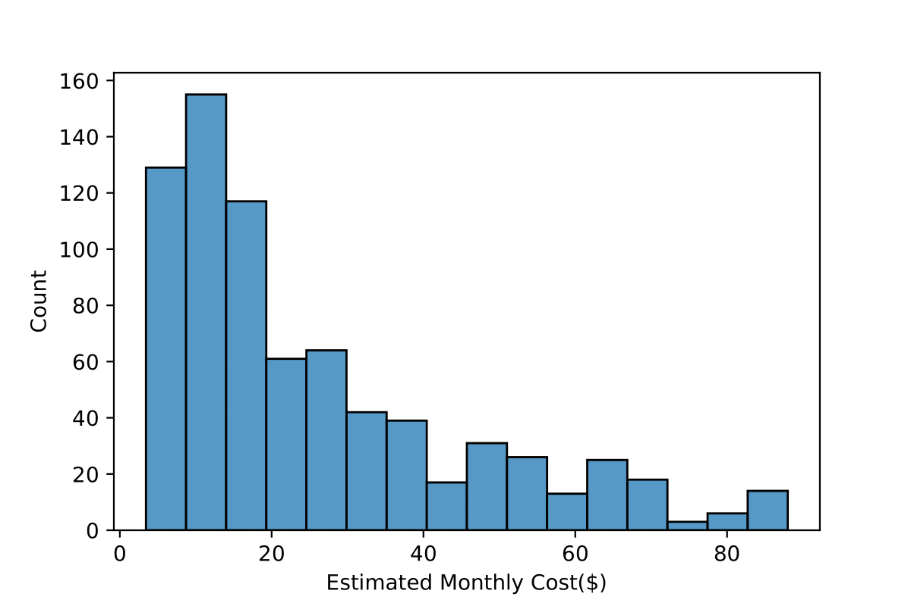
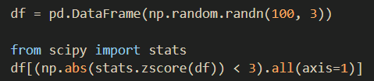
DATASET 3 insights
Final Dataframe:
1. Biggest dataset (1120 rows)
2. Many variables which can lead to a deep analysis later
3. Looking at distribution of Estimated Monthly Cost column:, it is positively skewed
Used code to detect outliers, no outliers in my dataset

Slide 24
Dataset 4: public transport average ridership (2009 & 2020)
Notes:
Now for the last dataset, age data sorted by ethnic group

Slide 25
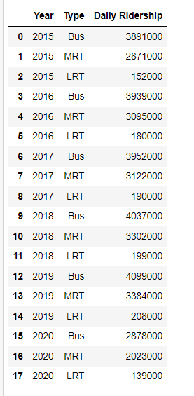
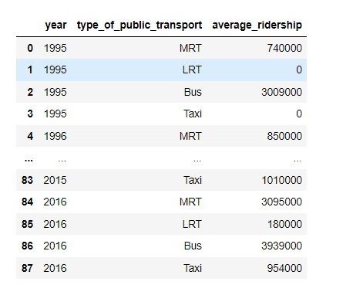
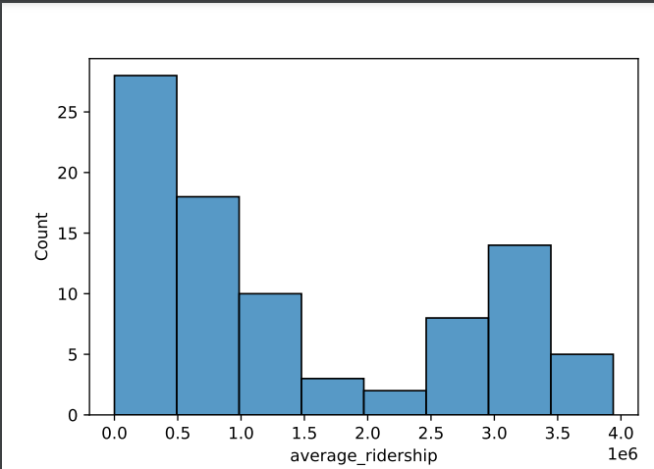
DATASET 4
2020
Shows average daily ridership of public transport by type (mrt/bus/lrt)
i.e total number of rides per day
2020 data only includes 2015-2020
2009 data contains 1995-2016
Peculiarities: 2020 data does not contain data for taxi ridership, but 2009 does
Distribution of ridership data is somewhat similar to a inverted bell curve.
2009
Notes:
Heres the numpy summary. I decided to use a histogram to analyse the shape of distribution of my data

Slide 26


DATASET 4 cleaning
Use of pd.concat() to merge 2009 and 2020 data
Use of pd.reset_index to reset the index from 0 onwards
Use of df.loc[] to filter data by year (get 2020 and 2009 specifically)
Notes:
Heres the numpy summary. I decided to use a histogram to analyse the shape of distribution of my data

Slide 27
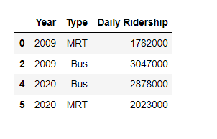
DATASET 4 insights
Final Dataframe:
1. Very compact dataframe
2. Overall, ridership is not too different between the years.
4,829,000 total in 2009
4,901,000 total in 2020
Notes:
Heres the numpy summary. I decided to use a histogram to analyse the shape of distribution of my data

Slide 28
conclusion

Slide 29
Suggestions
From our data comparing 2009 data to 2020 data: we can already see that 2020 costs are generally lower than 2009. This is a good sign because my investigation in DAVI is based around comparing the current distance-based fares against the non-distance based fares from 2009.
Student travel costs are much lower than adult travel costs, this will be a good place to look deeper in DAVI as my 2nd objective is for SP students
What I learnt
I have learnt the importance of planning ahead when conducting a data analysis, and having to adapt when faced with challenges.
Experiment with different pandas functions
Notes:
Suggestionss

Slide 30
Other references
https://www.creatifwerks.com/singapore-inflation-calculator/ Calculated 2009 to 2020 inflation
https://en-academic.com/dic.nsf/enwiki/11708139#Fares Singapore fares
https://www.weforum.org/agenda/2015/03/what-makes-people-use-public-transport/ Why public transport is important
Notes:
Suggestionss

Slide 31

thank you!
Notes:
Thanks

